Slide 1
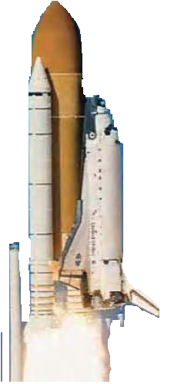

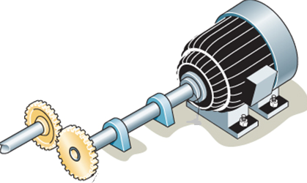
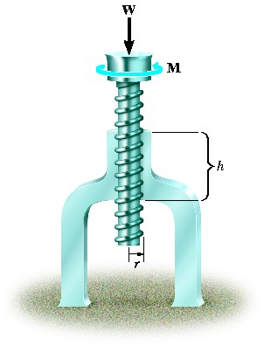
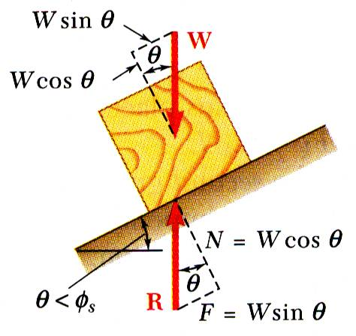
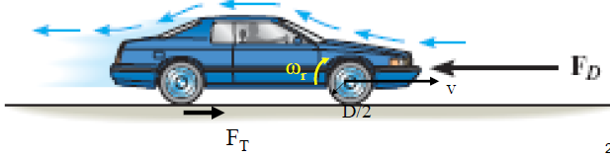
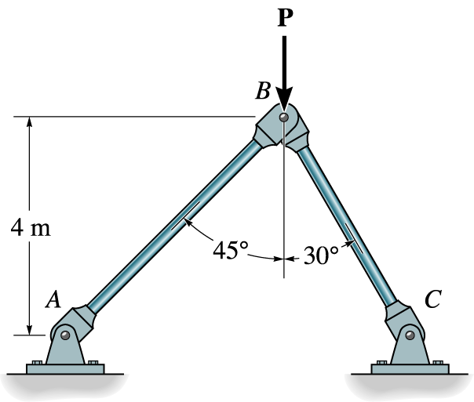


ENGINEERING MECHANICS
GE 107
Lecture 6

Slide 2
Introduction
Bodies differ from particles as their dimensions are not neglected
Bodies can be classified as rigid bodies, resistant bodies and deformable bodies.
A rigid body is an idealization of a solid body of finite size in which deformation is neglected.
A rigid body can be considered as a combination of a large number of particles in which all the particles remain at a fixed distance from one another, both before and after applying a load.
This model is important because the material properties of any body that is assumed to be rigid will not have to be considered when studying the effects of forces acting on the body.
In most cases the actual deformations occurring in structures, machines, mechanisms and the like are relatively small and the rigid-body assumption is suitable for analysis.

Slide 3
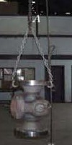
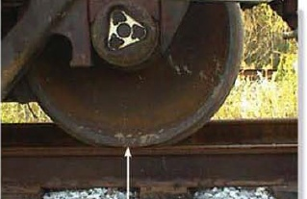
Introduction (Contd..)
Rail road wheel –rigid body
Hook – as an example of particle assumption

Slide 4
UNIT II EQUILIBRIUM OF RIGID BODIES
SYLLABUS
Moments and Couples – Moment of a force about a point and about an axis –Vectorial representation of moments and couples – Scalar components of a moment –Varignon’s theorem
Free body diagram – Types of supports and their reactions – requirements of stable equilibrium
Equilibrium of Rigid bodies in two dimensions
Equilibrium of Rigid bodies in three dimensions Examples

Slide 5
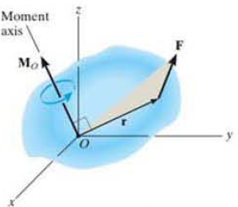
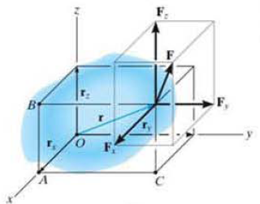
Cartesian Vector Formulation for Moment
Considering the coordinate axes x, y and z. then the position vector r and force F can be expressed as Cartesian vectors.
Applying cross product equation
where r_{x} , r_{y,} r_{z} represent the x, y, z components of the position Vector from point O to any point on the line of action of the force and
Fx ,Fy, Fz represent the force components of the force vector.

Slide 6
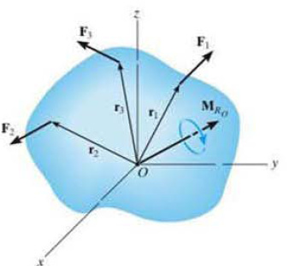
Resultant Moment of Forces
If a body is acted upon by a system of forces as shown in Fig.,
the resultant moment of the forces about point O can be determined by vector addition of the moment of each force.
This resultant can be written symbolically as

Slide 7
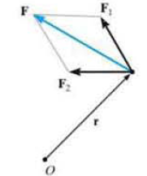
Principle of Moments
A concept often used in mechanics is the principle of moments, which is sometimes referred to as Varignon’s Theorem
It was originally developed by the French mathematician Varignon (1654- 1722).
It states that the moment of the of force about a point is equal to the sum of the moments of components of the force about that point.
This theorem can be shown by the distribution law of cross product.
Considering the forces shown in Fig.,
As
Therefore

Slide 8
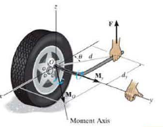
Moment of a Force about a
Specified Axis
Some times-the moment produced by a force about a specified axis must be determined.
For example, suppose the lug nut at a on the car tire as in Fig. needs to be loosened.
The force applied to the wrench will create a tendency for the wrench and the nut to rotate about axis passing through 0
But the nut can only rotate about the y axis.
Hence only the y component of the moment is needed and the total moment produced is not important.
To determine this component, we can use either a scalar or vector analysis.

Slide 9
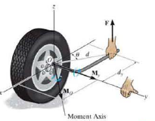
Moment of a Force about a Specified Axis (Contd..)
Scalar Method
To use a scalar analysis in the case of the lug nut as in Fig.,
the moment arm (perpendicular distance ) from the axis to the line of action of the force is
d_{y} = d cos θ.
Thus. the moment of F about the y axis is M_{y}=Fd_{y}= F(d cos θ).
According to the right-hand rule. M_{y} is directed along the positive y axis as shown in the figure.
In general, about any axis a, the moment is

Slide 10
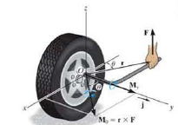


Moment of a Force about a Specified Axis (Contd..)
Vector Method
To find the moment of force F about the y axis using a vector analysis, we must first determine the moment of the force about the point 0 on the y axis by applying Equation Mo = r X F.
The component My along the y axis is the projection of Mo on the y axis.
It can be found using equation of dot product
  M _{y}= j · M_{o}= j . (r X F).
  where j is the unit vector for the y axis.
Let u_{d} be the unit vector along any axis a, then
The result can be written in the matrix form as

Slide 11
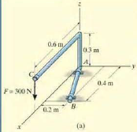
Problem 1
Determine the moment M_{AB} produced by the force F in Fig.a, which tends to rotate the rod about the AB axis.

Slide 12

Solution to Problem 1
Scalar method cannot be applied as find the perpendicular distance is difficult.
Using Vector method
  Where u_{B} is the unit vector along AB which can be found as
      r_{B} is the position vector from A to B
      the coordinates for point B is (4,2,0 ) and that of A is (0,0,0)
  Vector r in the moment equation is a vector directed between any point on line AB to the line of action of force F

Slide 13
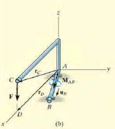
Solution to Problem 1 (Contd.)
It can be the vector r_{C} or r_{D} also.
Considering the coordinates for point D from A.
The force is

Slide 14
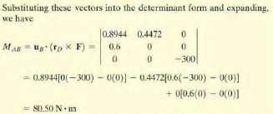

Solution to Problem 1 (Contd..)

Slide 15
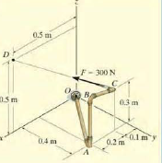
Problem 2
Determine the magnitude and direction of moment of force F about segment OA

Slide 16

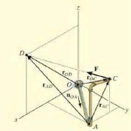

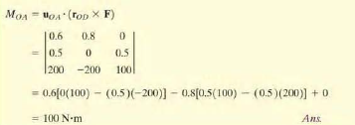
Solution to Problem 2
To get the force in vector form ,
find the unit vector along OA
Find the position vector for force segment OA
Hence the moment about OA is

Slide 17
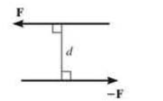
Moment of a Couple
A couple is defined as
  two parallel forces
  that have the same magnitude
  but opposite directions and
  are separated by a perpendicular distance ‘d’.

Slide 18
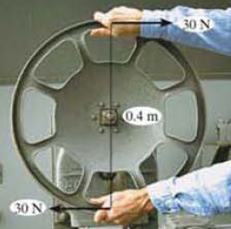
Moment of a Couple (Contd..)
For example, imagine that you are driving a car with both hands on the steering wheel and you are making a turn.
One hand will push up on the wheel while the other hand pulls down, which causes the steering wheel to rotate
Since the resultant force is zero, the only effect of a couple is to produce a rotation or tendency of rotation in a specified direction.
This is nothing but a moment or moment of a couple
The moment produced by a couple can be called as Couple Moment.

Slide 19
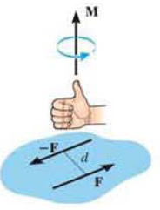

Couple Moment -
Scalar Formulation
The moment of a couple as shown in the Fig. is defined as having a magnitude of
  Where F is the magnitude of one of the forces and
  d is the perpendicular distance or moment arm between the forces.
The direction and sense of the couple moment are determined by the right hand rule,
  where the thumb indicates this direction and
  the fingers are curled with the sense of rotation caused by the couple forces.
In all cases, M will act perpendicular to the plane containing the forces.

Slide 20
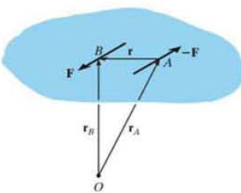
Couple Moment – vector Formulation
Moment can be determined by finding the sum of the moments of both couple forces about any arbitrary point.
For example as in Fig. the position vectors r_{A} and r_{B} are directed from point 0 to points A and B lying on the line of action of - F and F
The couple moment determined about 0 is
But the position vectors are added as
Hence
This result indicates that a couple moment is a free vector i.e., it can act at any point since M depends only upon the position vector r directed between the forces.

Slide 21
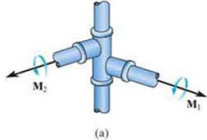
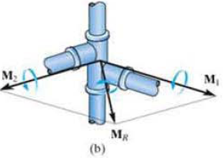

Resultant Couple Moment
Since couple moments are vectors, their resultant can be determined by vector addition.
For example, consider the couple moments M₁ and M₂ acting on the pipe as shown in the Fig.a.
Since each couple moment is a free vector, we can join their tails at any arbitrary point and find the resultant couple moment as shown in Fig.b.
M_{R}=M₁+M₂
If more than two couple moments act on the body, we may generalize this concept and write the vector resultant as

Slide 22
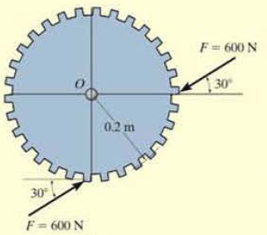
Problem 3
Determine the magnitude and direction of the couple moment acting on the gear as shown in the Figure. (R.C. Hibbeler p151)

Slide 23
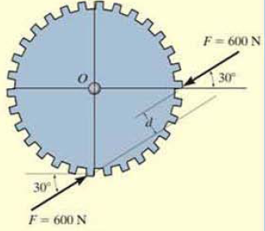
Solution to Problem 3
Scalar Approach
  The distance d can be found graphically and
  substituting in the formula M= Fd , its magnitude can be found
  Analytical method to find d is complicated and hence vector approach is used

Slide 24
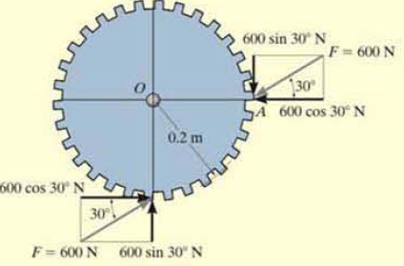

Solution to Problem 3 (Contd..)
The forces are resolved in to two components
The moments of respective resolved components are found about any point (say O)
Summing up the moments will give the resultant couple moment caused by the forces
This positive result indicates that M has a counter clock wise rotational sense and it is directed outward . perpendicular to the board.
600 sin30°N
0.2 m
M₁
600 sin30°N
0.2 m
600 cos30°N
M₂
600 cos30°N

Slide 25
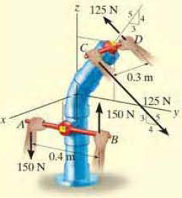
Problem 4
Replace the two couples acting on the pipe column as shown in the figure by a resultant couple moment.

Slide 26
Solution to Problem 4
Let the couple moments M₁ and M₂ are produced by the forces F₁ and F₂ respectively
  Where F₁ = 150 N and F₂= 125 N
The vector M₁ is given as

Slide 27
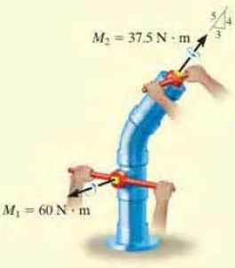
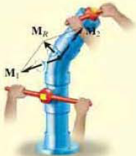
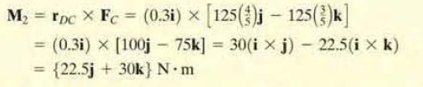
Solution to Problem 4 (Contd..)
The vector M₂ is computed in the similar manner as
The resultant moment is thus

Slide 28
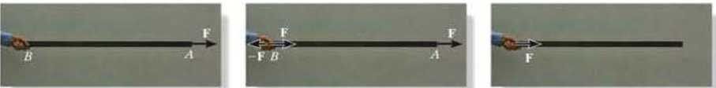
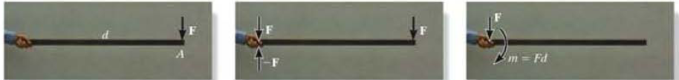
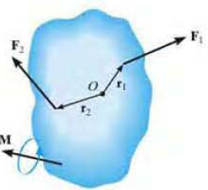
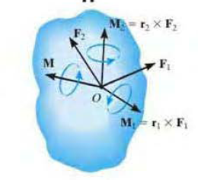
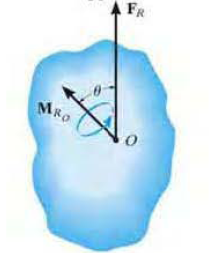

Simplification of Force and couple system

Slide 29
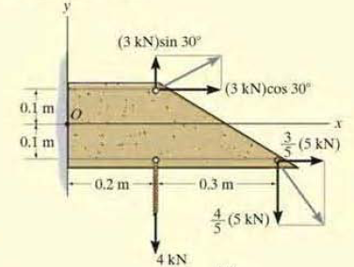
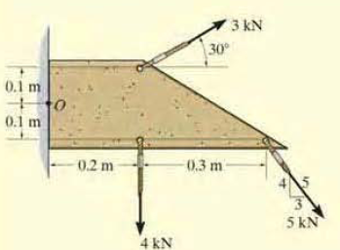


Example

Slide 30
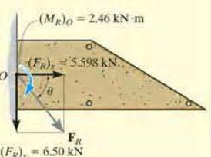
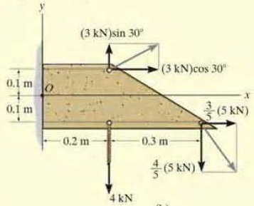
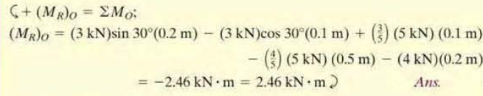
Example (Contd.)

Slide 31
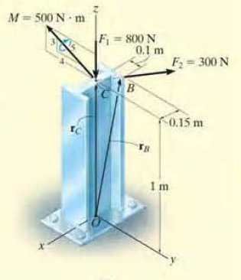
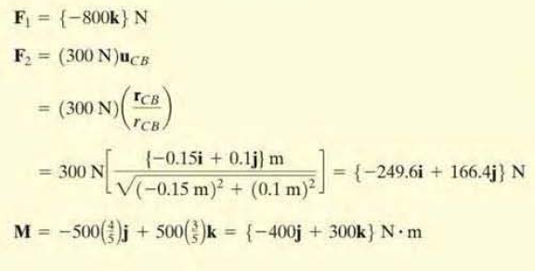

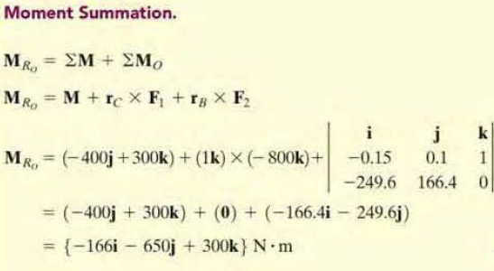
Problem 5
Find the resultant moment for the system shown

Slide 32
Single Equivalent Force
Analysis of any system requires simplification
A system acted upon by many forces and couples can be first converted in to single resultant force and single resultant moment system.
This can be further reduced into a single equivalent force system

Slide 33
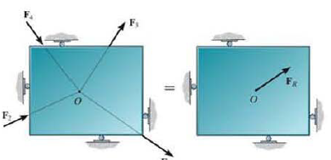
Single Equivalent Force (Contd.)
For a concurrent system, in which the lines of action of all the forces intersect at a common point O, the force system produces no moment about this point.
As a result, the equivalent system can be represented by a single resultant force F_{R} .

Slide 34
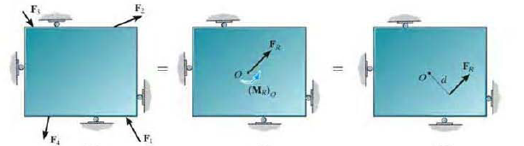
Single Equivalent Force (Contd.)
For a coplanar system of force the lines of action of all the forces lie in the same plane.
So the resultant force of this system also lies in this plane.
Furthermore, the moment of each of the forces about any point 0 is directed perpendicular to this plane.
Thus, the resultant moment M_{R} and resultant force F_{R} will be mutually perpendicular.
The resultant moment can be replaced by moving the resultant force F_{R} to a perpendicular or moment arm distance d away from point 0 such that F_{R} produces the same moment M_{RO} about point O.
This distance d can be determined from the scalar equation (M_{R})o = F_{R}d

Slide 35
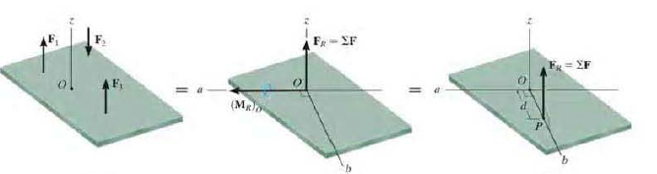
Single Equivalent Force (Contd.)
For the parallel force system as shown in Figure, forces are parallel to the y axis.
Thus, the resultant force F_{R} at point 0 must also be parallel this axis.
The moment produced by each force lies in the plane o f the plate, and so the resultant couple moment, M_{R}. will also lie in this plane along the moment axis a, since F_{R} and M_{R} o are mutually perpendicular.
As a result, the force system can be further reduced to an equivalent single resultant force F, acting through point P located on the perpendicular b axis
The distance d along the b axis from point 0 requires

Slide 36


Single Equivalent Force (Contd.)
If there is a distributed force system as shown in the figures below
For case shown above, the uniformly distributed load 6kN/m can be represented by a single force
  whose magnitude equals to magnitude of the UDL times
  the length along which it is distributed
  And its position would be middle of the length along which it is distributed
  For the loading shown, it is 6 X 6=36 kN
36 kN

Slide 37




Single Equivalent Force (Contd.)
For the variably distributed loading shown in Figure below:
The single force representation can be obtained as
  The magnitude of the equivalent force is equal to the area of the triangle formed by the VDL which is ½ ( b X h)
  the length along which it is distributed
  And its position would be at the centroid of triangle which is 1/3 h

Slide 38

Problem 6
Determine the resultant force and specify where it acts on the beam measured from A .
(Ans: 24.75 kN and 2.59 m)

Slide 39
Free Body Diagram
A complete understanding of all the known and unknown external forces for the successful application of the equilibrium equations is required
The best way to account for these forces is to draw a free-body diagram.
This diagram is a sketch of the outlined shape of the body, which is isolated from its surroundings (free body).
It also shows all the forces and moments that the surroundings exert on the body.

Slide 40
Support Reactions
A body will have six degrees of freedom in space
When ever it is constrained or restricted to move it will produce reactions (forces)
If it is not allowed to translate it will produce forces and
If the rotation is restricted, it will give rise to moments
A support may arrest some of the rotations and/ or translations and hence it produces reactive forces and moments

Slide 41

Support Reactions in 2D
            Roller Support
              –restricts translation in y direction
              –reaction force developed in y direction
            Hinged or Pinned Support
            – restricts translations in x as well as y direction
            – reaction forces developed in x as well as y direction
            Fixed Support
            – restricts translations in x and y direction and also the rotation .
            – reaction forces developed in x and y direction and a reactive moment developed .

Slide 42

Support Reactions (Contd..)

Slide 43

Support Reactions (Contd..)

Slide 44

Support Reactions (Contd..)

Slide 45


Support Reactions (Contd..)

Slide 46
Reactions in 3D
Z
Y
Z
Z
F_{Z}
M_{Z}
F_{Z}
Y
M_{Z}
M_{Y}
M_{Y}
F_{Y}
F_{Y}
Y
X
Find the constraint forces and moments for the given assembly and show them in the FBD
X
F_{X}
F_{X}
X
FBD of 1
FBD of 2
As the shaft system is free to move in one direction only (rotate around X), it has five constraints namely Fx, Fy, Fz, M_{Z} and M_{y}.

Slide 47
Exercises
Problem 1
Problem 2
Problem 3
Problem 4

Slide 48




Problem 6
Draw the Free body diagram of beam

Slide 49





Problem 7
Two smooth pipes each having a mass of 300 kg. arc supported by the forked tines of the tractor as in Fig. Draw the free body diagrams for each pipe and both pipes together

Slide 50

Condition For Equilibrium
The force and couple moment system acting on a body can be reduced to an equivalent resultant force and resultant couple moment at any arbitrary point O on or off the body.
lf this resultant force and moment are both equal to zero, then the body is said to be in equilibrium. i.e.,

Slide 51
Condition For Equilibrium (Contd..)
When applying the equations of equilibrium, it is assumed that the body remains rigid.
In reality, all bodies deform when subjected to loads
Most engineering materials such as steel and concrete are very rigid and so their deformation is very small.
When applying the equations of equilibrium, it is generally assumed that the body will remain rigid and not deform under the applied load.
Hence the direction of the applied forces and their moment arms with respect to a fixed reference remain unchanged before and after the body is loaded.

Slide 52





Problem 8
Determine the reactions on the beam

